Slide 1


COVID-19
COVID-19 Deaths: A study of race disparity

Slide 2
Objective
This project aims at studying racial and ethnic disparities in healthcare base on deaths that are related to the COVID-19 pandemic.

Slide 3
Introduction
What is health disparity?
Health disparity refers to systematic differences in health outcomes between groups and communities based on socioeconomic isolation.

Slide 4
Causes of COVID-19 Health Disparities
1- Limited access to quality medical care and other beneficial resources and services.
2- Lack of viable resources and information

Slide 5
Statistics
States % Total population Deaths
Louisiana 32% black /68% white 70% black vs 28% white
Illinois/380 deaths 15% black/77 white 43% black vs 36% white/8.4% Hispanics/3.7% Asians
New York 29% Hispanics/ 22% Black 28% Black/ 34% Hispanics

Slide 6
Methods
The dataset used from this project was obtained from data.gov. It is a collection of the statewide confirmed and probable COVID-19 related deaths that have been reported each day by the Vital Statistics Administration by categories of race and ethnicity. The collection provides confirmed COVID-19 deaths among Maryland residents by race and ethnicity.

Slide 7

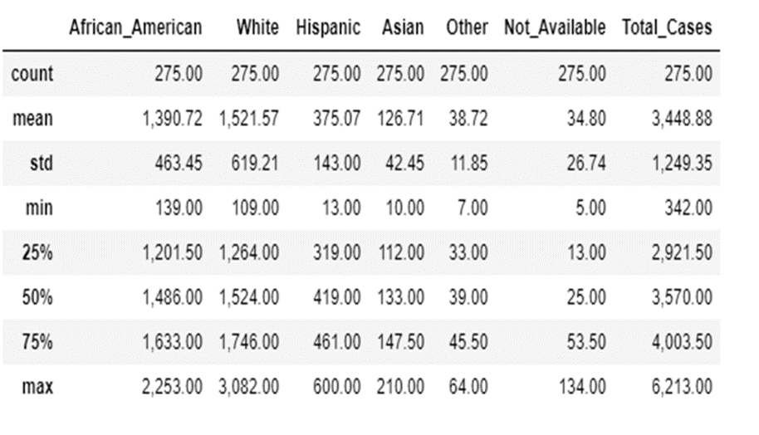
The Data+ Target Variables

Slide 8
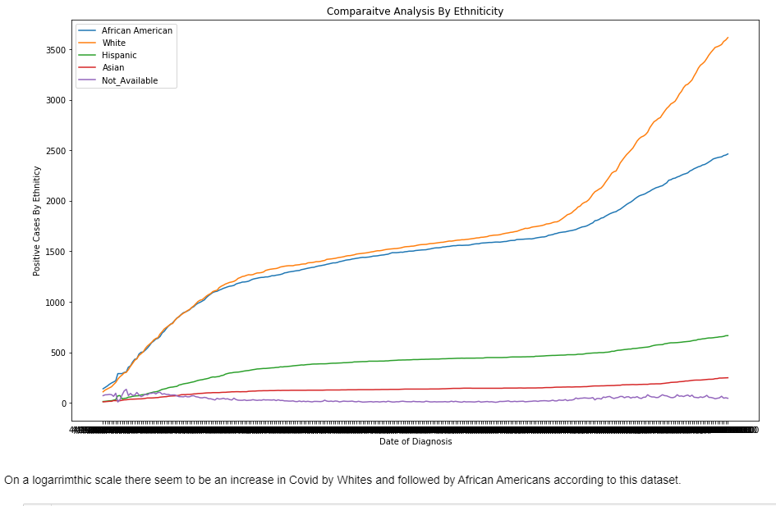
Results

Slide 9
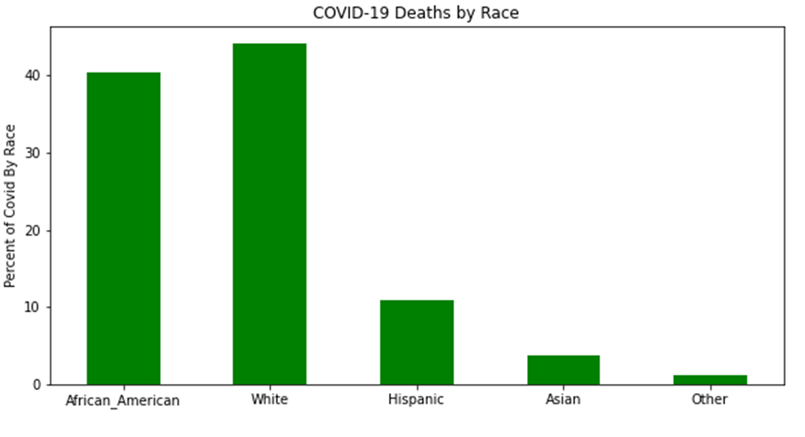
Results (Cont.)

Slide 10
Code
Github
https://cherf001.github.io/Frenel-Cherubun/

Slide 11
References
1- Artiga S, Orgera K, Pham O, Corallo B.: Growing data underscore that communities of color are being harder hit by COVID-19
https://www.kff.org/coronavirus-policy-watch/growing-data-underscore-communities-color-harder-hit-covid-19/?utm_campaign=KFF-2020-Medicaid&utm_source=hs_email&utm_medium=email&utm_content=86645517&_hsenc=p2ANqtz%2D%2DRBk58ZkW7WUKTgP6RM7OlSdkJW5McG2Mkh6AAb_kfx.
2-Kampf G, Todt D, Pfaender S, Steinmann E.: Persistence of coronaviruses on inanimate surfaces and their inactivation with biocidal agents. J Hosp Infect. 2020;104:246–51.
https://linkinghub.elsevier.com/retrieve/pii/S0195670120300463. [PMC free article] [PubMed]
3-Louis-Jean J, Aime M. On the novel coronavirus (COVID-19): a global pandemic. J Teknol Lab. 2020;9:103–14. 10.29238/teknolabjournal.v9i1.230.
4-Samantha Artiga Follow, Bradley Corallo, and Olivia Pham: Racial Disparities in COVID-19: Key Findings from Available Data and Analysis, Aug 17, 2020
https://www.kff.org/racial-equity-and-health-policy/issue-brief/racial-disparities-covid-19-key-findings-available-data-analysis/
5-Wang C., Liu Z., Chen Z., Huang X., Xu M., He T. The establishment of reference sequence for SARS-CoV-2 and variation analysis. J Med Virol. 2020 [PMC free article] [PubMed]
6-Centers for Disease Control: COVID-19 Racial and Ethnic Health Disparities
https://www.cdc.gov/coronavirus/2019-ncov/community/health-equity/racial-ethnic-disparities/index.html

Slide 12
References (Cont.)
7-World Health Organization: Coronavirus Disease 2019
https://www.who.int/docs/default-source/coronaviruse/situation-reports/20200406-sitrep-77-covid-19.pdf?sfvrsn=21d1e632_2
8-https://coronavirus.app/map?mode=infected
9- https://www.who.int/emergencies/diseases/novel-coronavirus-2019
10-Families First Coronavirus Response Act. United States of America: U.S. Government Publishing Office. 2020 p. 177–220.
11- Louisiana Population 2020 (Demographics, Maps, Graphs). World Popul. Rev. 2020.
https://worldpopulationreview.com/states/louisiana-population/.
12-Coronavirus Disease 2019 (COVID-19) in Illinois test results. Illinois State Dep. Public Heal. 2020.
http://dph.illinois.gov/covid19/covid19-statistics.
13- Fatalities. New York State Dep. Public Heal. 2020.
https://covid19tracker.health.ny.gov/views/NYS-COVID19-Tracker/NYSDOHCOVID-19Tracker-Fatalities?%3Aembed=yes&%3Atoolbar=no&%3Atabs=n.

